Slide 1

Holistic AWS Cloud Security Design for Organizations New to Cloud
Cassandra Young
BSides Charm 2022

Slide 2

Cassandra Young (aka muteki)
Senior Scientist, Cloud Security @ Security Risk Advisors
Master’s of Computer Science @ University of Pennsylvania
Director & Meet-a-Mentor Lead @ Blue Team Village
Lives for international travel, aurora chasing & scuba diving, Star Trek & jigsaw puzzles
Cassandra Young (she/her) Twitter: @muteki_rtw GitHub: github.com/muteki-apps LinkedIn: linkedin.com/in/cassandray

Slide 3
Agenda Slides & Activities: https://bit.ly/37PgYON
Part Zero: Cloud Overview & Security Design
Part One: AWS Accounts and Organizations
Presentation: Accounts & Organizations
Activity: Setting up & securing your Organization
Presentation cont’d: Control Tower
Part Two: Identity & Access Management
Presentation: Identity & Access Management in AWS
Activity: Users, permissions, & access
Presentation cont’d: AWS SSO & 3rd Party Integration
Part Three: Visibility & Security
Presentation: Logging and Monitoring Tools, AWS Security Tooling
Activity: Testing Security Tools
Activity: Implementing CloudTrail for your Organization
Part Four: Networking from On-Prem to the Cloud
Presentation: Networking
Part Five: Secure Pipelines & Automation
Presentation: Securing Code & Images, CI/CD Pipelines, Infrastructure Automation with Infrastructure as Code
Part Six: Pulling it All Together

Slide 4

Part Zero: Cloud Overview & Security Design

Slide 5
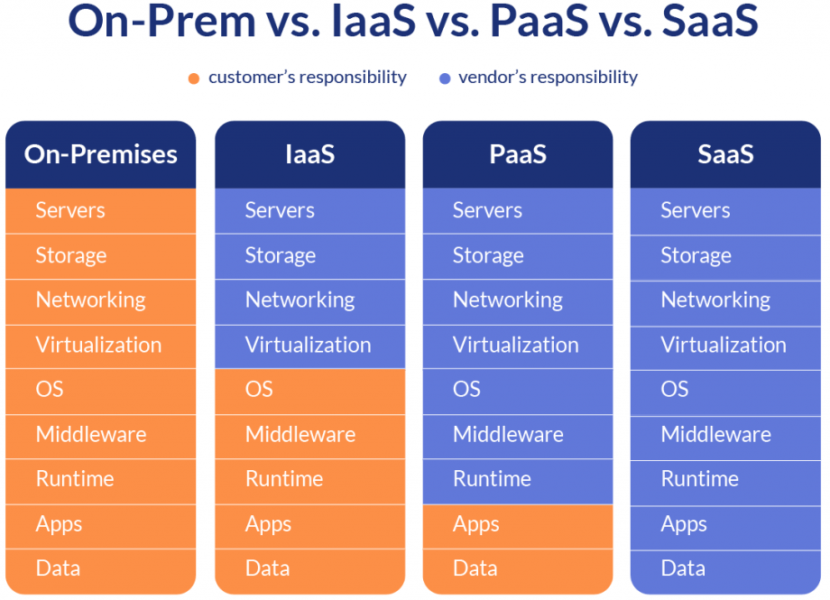
The Shared Responsibility Model
Varying levels of access and control requires flexible thinking when designing for security

Slide 6
Designing Cloud Security
Cloud Platform Design
Architecture (Account, Infrastructure & Application)
Network (Layout & Traffic Inspection)
Identity & Access Management
Secure CI/CD Pipeline & Automation
Service Protection & Hardening
Logging & Monitoring
Data Protection
Service-level Hardening
Resilience & Disaster Recovery
Policy & Process
Governance
Vulnerability Management
Incident Response
What areas should a robust cloud security plan cover?

Slide 7

Part One: AWS Accounts & Organizations

Slide 8
AWS Accounts: Overview
an AWS account is the basic container for all AWS resources you create as a customer, ie. virtual machines, databases and storage accounts
Accounts represent a default security boundary, restricting access to resources to users in the account.
Resources within an account can be further subdivided by region, and segmented using Virtual Private Clouds (VPCs), network controls, IAM Roles & Policies, & more…

Slide 9
AWS ACCOUNT
REGION US-EAST-1
REGION US-EAST-2
AVAILABILITY ZONE A
AVAILABILITY ZONE B
AVAILABILITY ZONE C
AVAILABILITY ZONE D
VPC 1
VPC 2
VPC 3
VPC 4

Slide 10
AWS Accounts: Security
Root User Accounts
Root user is the primary administrator of an AWS account
Secure access to email account associated with root user
Enable MFA, secure & restrict access to MFA method
Break-glass users must be tightly controlled and monitored
This account should be enabled, but secured and never used!!
Billing alerts
Set up billing alerts immediately!
Configure email and/or other service notifications to trigger when charges exceed a set threshold

Slide 11
AWS Organizations: Overview
Why use multiple accounts?
Logical groupings fit for purpose
Multi-account environment reduces blast radius
Centrally manage billing & billing alerts
OUs allow easy grouping by security restriction levels
Aligns with best practices for compliance

Slide 12
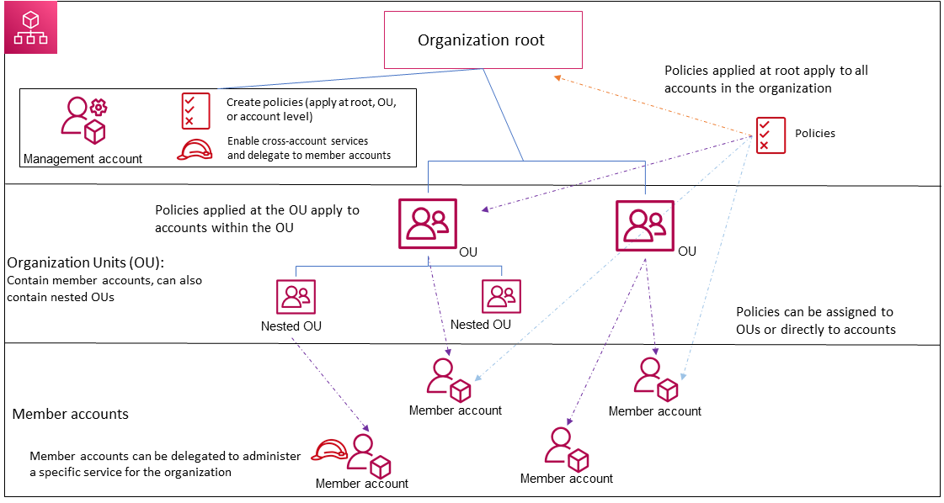
AWS Organizations: Overview
AWS Organizations enables companies to scale and centrally manage secure multi-account environments by grouping accounts within Organizational Units (OUs), and scoping access to services using Service Control Policies (SCPs)

Slide 13
AWS Organizations: Securing the Management Account
The AWS Organizations Management Account is “Root”!
Use management account only for tasks that require it
Use a group/shared email account for the management account's root user, & secure access to that account
Use a complex password for the account's root user
Enable MFA for root user credentials & store securely
Add a phone number to the account contact information
Review and keep track of who has access
Document processes for using the root user credentials
Closely monitor access to root user credentials, whether successful or not

Slide 14
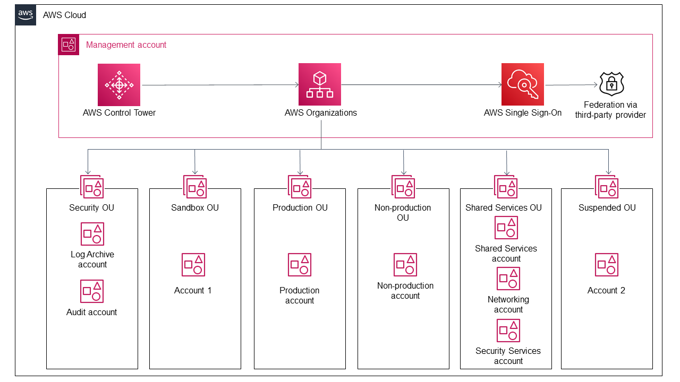
AWS Organizations: Organizational Units
OUs represent logical groupings of accounts
Group by function or common controls
Review AWS recommended OU structures

Slide 15
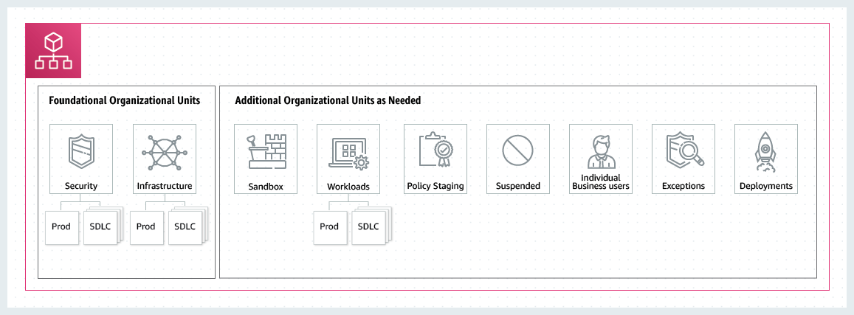
AWS Organizations: Organizational Units
AWS provides guidance on OU structures
Separate prod and non-prod accounts within OUs
Maintain a Security OU
https://aws.amazon.com/organizations/getting-started/best-practices/

Slide 16
AWS Organizations: Service Control Policies
Service Control Policies (SCPs) are used to enforce permissions guardrails at the OU and account level
Used to define the maximum available permissions
Prevent or remediate high-risk configurations at the organizational level
Restrict access to unapproved AWS services
Apply to individual accounts, OUs, and nested OUs

Slide 17
AWS Organizations: Service Control Policies
Prevent Users from Disabling AWS CloudTrail
Deny access to AWS based on the requested AWS Region
Require a tag on specified created resources
Prevent users from disabling/changing AWS Config
Prevent Creation of New IAM Users/ Access Keys
Prevent non-public VPCs from getting public internet access

Slide 18
Activity One ~40 mins
Create new AWS account
NOTE: This will be the Organization management account! Do not use an existing account for this.
Secure root user with MFA
Set billing preferences
Create Organization
Create a member account
Create new Organizational Units
Create two Service Control Policies
Apply SCPs to OUs
Move member account into OU
Configure member account
Test the SCP with S3
Move member account between OUs
BONUS: Configure Billing Alarm with CloudWatch
Setting Up & Securing Your Organization https://bit.ly/37PgYON

Slide 19
Extending Organizations: Control Tower
Control Tower extends AWS Organizations, allowing you to orchestrate capabilities of multiple underlying services to create a Landing Zone foundational AWS environment for seamless account creation and governance
Why Control Tower?
Allows for more granular control over AWS environments
Use to manage multiple AWS Organizations
Offers the ability to templatize new account creation

Slide 20
Extending Organizations: Control Tower
Landing zone
A well-architected, multi-account environment based on security and compliance best practices. Can scale to fit the needs of an enterprise of any size.
Guardrails
A high-level rule that provides ongoing governance for your AWS environment. Guardrails can be preventive or detective.
Account Factory
A configurable account template to standardize the provisioning of new accounts with pre-approved account configurations.
Dashboard
The dashboard offers continuous oversight of your landing zone to your team of central cloud administrators.

Slide 21

10 Minute Break

Slide 22

Part Two: Identity & Access Management

Slide 23
Identity & Access Management
use AWS IAM to control who can authenticate to your environment, and who has authorization to perform which actions on a given resource, and under what conditions

Slide 24
Identity & Access Management: Identities & Principals
Identity: An IAM resource object used to identify and group.
Account Root User
IAM User
Used to represent a person or application
Identified by an ARN
Can authenticate with a console password, access keys or other methods (variable by service)
IAM User Group
Permissions may be granted based on membership in a user group.
IAM Role
An entity assumes a role to perform actions
Roles may be assumed by users and also AWS services
Principal:
An authenticated IAM User or Role (used by an AWS Service or application) which performs an action or operation.

Slide 25
Identity & Access Management: Policies
policies describe what actions are allowed to be performed by a principal on a given resource, and under what conditions
Identity-based policies:
Control what actions the identity can perform, on which resources, and under what conditions.
Managed policies: Standalone identity-based policies that you can attach to multiple users, groups, and roles in your AWS account.
Inline policies: Policies that you create and manage and that are embedded directly into a single user, group, or role. In most cases, we don't recommend using inline policies.
Resource-based policies:
Control what actions a specified principal can perform on that resource and under what conditions. Resource-based policies are inline policies, and there are no managed resource-based policies.

Slide 26
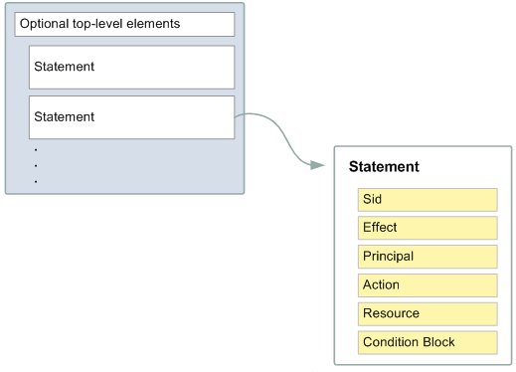
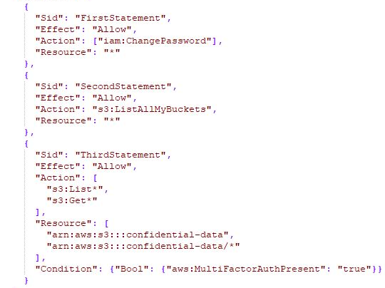
Identity & Access Management: Policies

Slide 27
Identity & Access Management: Roles
a role is an IAM identity with attached policies that determine what it can and cannot do, and which is assumable by entities that need it, providing temporary security credentials for the role session
Use roles to delegate access to users, applications, or AWS services
Can be used to grant external AWS IAM users permissions within your environment
Decouples IAM user identities from the explicit permission sets granted to them

Slide 28
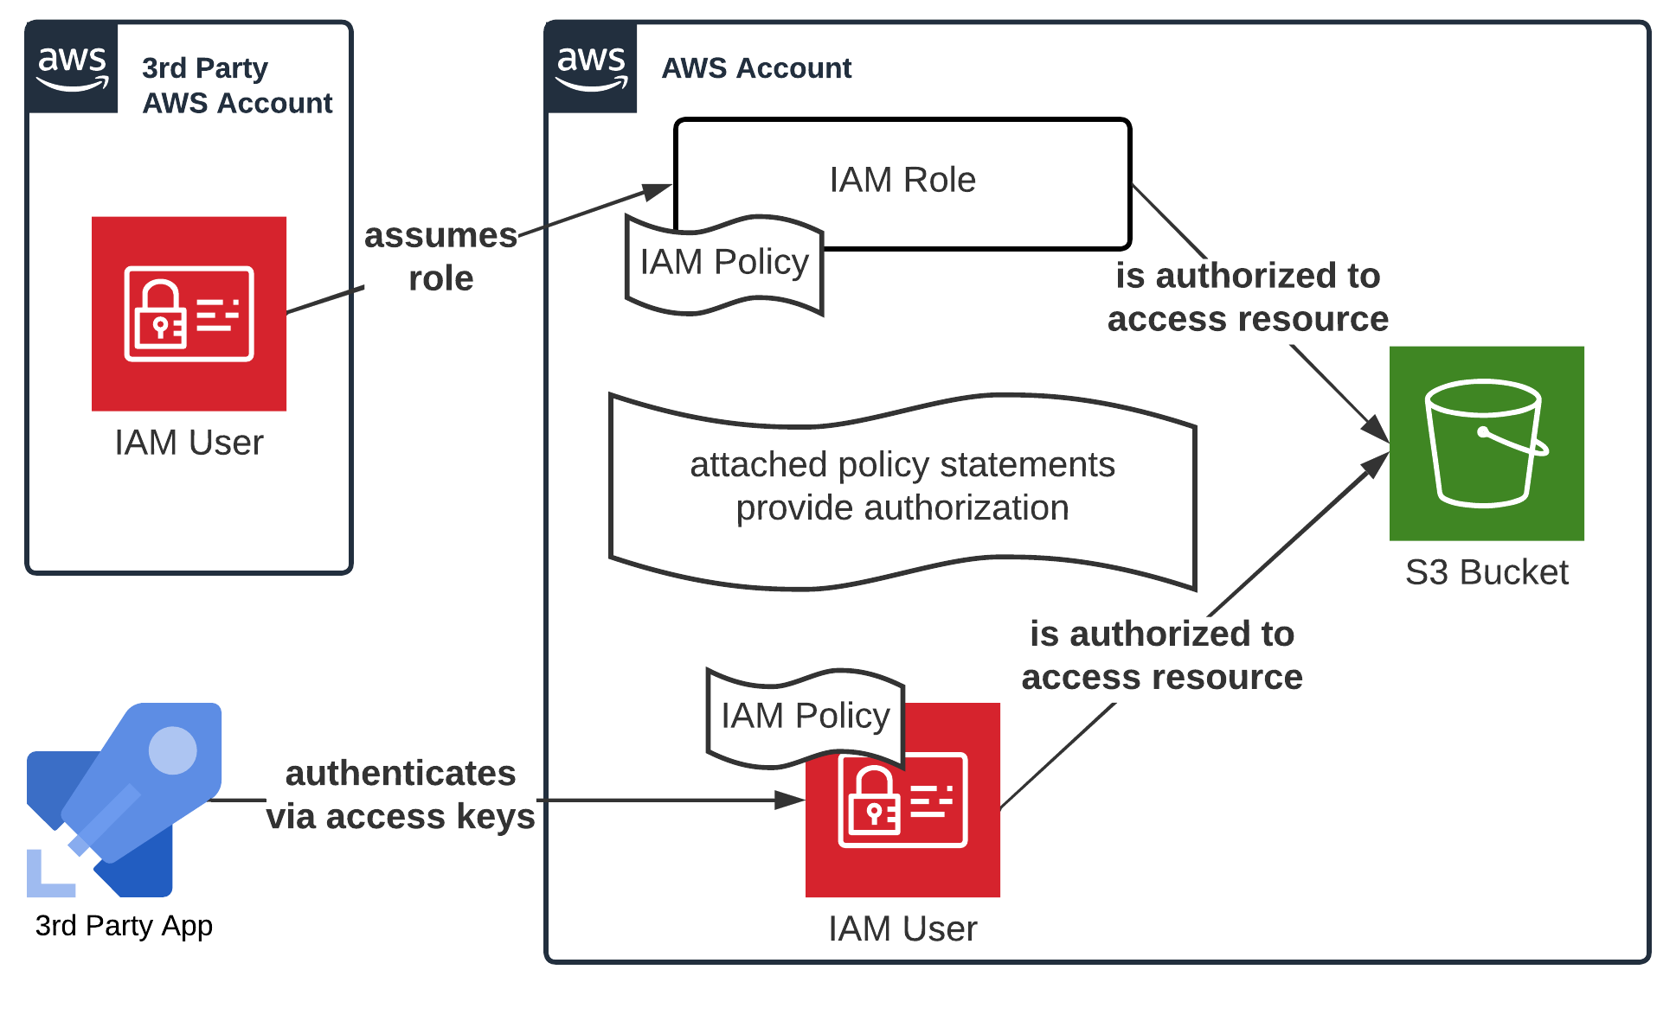
Identity & Access Management: Bringing it all Together

Slide 29
Identity & Access Management: Policies Cont’d
In addition to role-based access control (RBAC), you can use attribute-based access control (ABAC) to define permissions based on attributes such as tags.
Use policy conditions to define the conditions under which identity-based policies allow access to resources, ie. source IP address or use of MFA within a timeframe.
Take advantage of the granular control available within AWS IAM to implement the principle of least privilege

Slide 30
Activity Two: ~30 mins
Create new IAM user
Create and apply an identity-based policy
Grant S3 permissions to user
Test uploading files to S3 as the IAM user
Create and apply a resource-based policy
Test the resource-based policy
BONUS: Bucket administration through IAM
BONUS: Policy conditions
BONUS: Restrict IAM at the Organizational level
IAM User Access and Policies
https://bit.ly/37PgYON

Slide 31
Extending IAM: Integration with AWS SSO
AWS SSO enables you to incorporate your existing identity source into AWS and map authenticated users to IAM roles and permissions
Why SSO?
Localized, “non-federated” IAM adds complexity, management burden and risk of password compromise
Enables you to implement least privilege access with roles in your identity provider, not in AWS directory.
Support for:
Microsoft Active Directory
Okta Universal Directory
Azure Active Directory (Azure AD)

Slide 32

5 Minute Break

Slide 33

Part Three: Visibility & Security

Slide 34
Visibility & Security: Logging
CloudTrail
Audit actions taken by users, roles and AWS services
Use for identifying security incidents via integrations
Export to S3 bucket for SIEM integration
CloudWatch
Use to extend CloudTrail to Events, Alerts
VPC Flow Logs
Track network interface traffic
Enable in all VPCs and export
Service-level logging:
Most AWS services can be configured to log additional service-specific behavior

Slide 35
Visibility & Security: Logging
Logging for Organizations:
Centralize logging across all accounts with Organizational CloudTrail
Export to Log Archive account for SIEM integration
Monitor and enforce CloudTrail compliance using SCPs and AWS Config

Slide 36
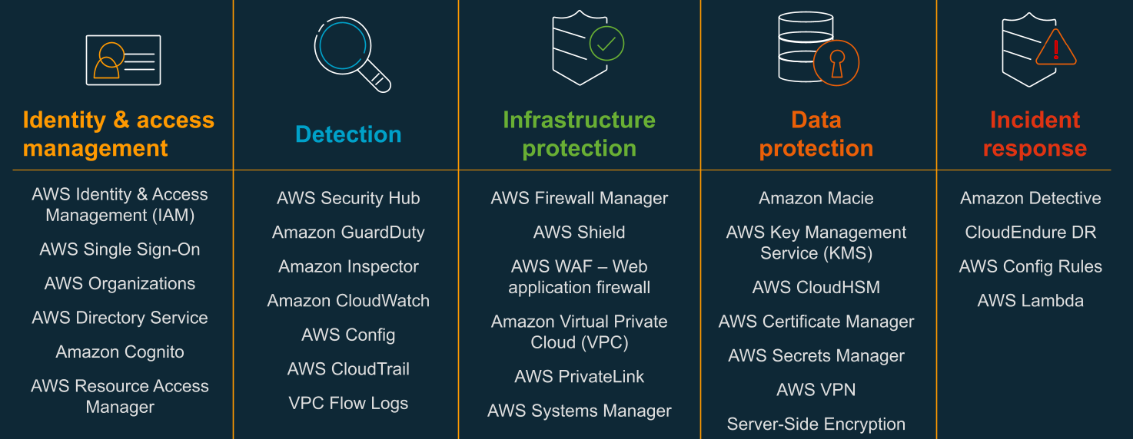
Visibility & Security: Security Tools

Slide 37
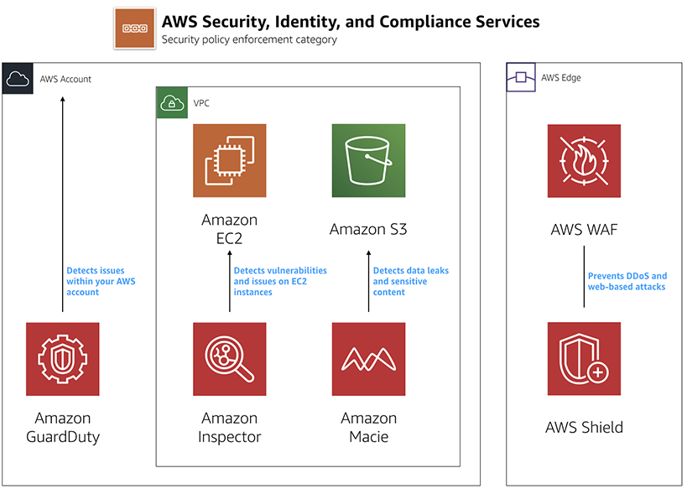
Visibility & Security: Security Tools

Slide 38
Visibility & Security: Detection: Security Hub
AWS Security Hub is a cloud security posture management service that performs automated, continuous security best practice checks against your AWS resources

Slide 39
Visibility & Security: Detection: AWS Config
AWS Config enables you to assess, audit, and evaluate the configurations of your AWS resources, continuously monitoring resource configurations and comparing them to your desired configurations

Slide 40
Visibility & Security: Detection: GuardDuty
GuardDuty is a threat detection service that continuously monitors your accounts and workloads for malicious activity and delivers detailed security findings for visibility and remediation

Slide 41
Visibility & Security: Data Protection: Amazon Macie
Amazon Macie is a fully managed data security and data privacy service that uses machine learning and pattern matching to discover and protect your sensitive data in AWS

Slide 42
Visibility & Security: Data Protection: Secrets Manager
AWS Secrets Manager protects secrets needed to access your applications, services, and IT resources, enabling you to rotate, manage, and retrieve database credentials, API keys, and other secrets throughout their lifecycle

Slide 43
Visibility & Security: Data Protection: Key Management Service
AWS KMS enables you to create and manage cryptographic keys and control their use across AWS services and in your applications, including integration with AWS CloudTrail logging for regulatory and compliance needs

Slide 44
Activity 3: 20 mins
Enable Macie
Enable Security Hub
Enable and set rules in AWS Config
View noncompliant rules in AWS Config
View Amazon Macie findings
View Security Hub findings
Create an organization trail
View exported logs
Security Tools & Logging
https://bit.ly/37PgYON

Slide 45
5 Minute Break

Slide 46

Part Four: Networking from On-Prem to Cloud

Slide 47
Networking from On-Prem to Cloud: AWS Networking
Virtual Private Cloud (VPC) enables you to launch AWS resources into a virtual network that you've defined. This virtual network closely resembles a traditional network that you'd operate in your own data center
Logically isolated from other virtual networks in AWS
Control your virtual networking environment, including resource placement, connectivity, and security
Divide and control with Subnets, Security Groups, and Network ACLs
Not all AWS services can be launched into a VPC!

Slide 48
Networking from On-Prem to Cloud: Extending On-Prem
Use Site-to-Site VPN, Direct Connect, and other services to connect your on-prem to the cloud
Best practice: use Hub & Spoke model
Commonly used services such as domain controllers, internet gateways, connections to other cloud environments, and connections to on-premise datacenters should be centrally located to be consumed by all environments
Design networking appropriate to your environment, scaling needs, and data sensitivity

Slide 49
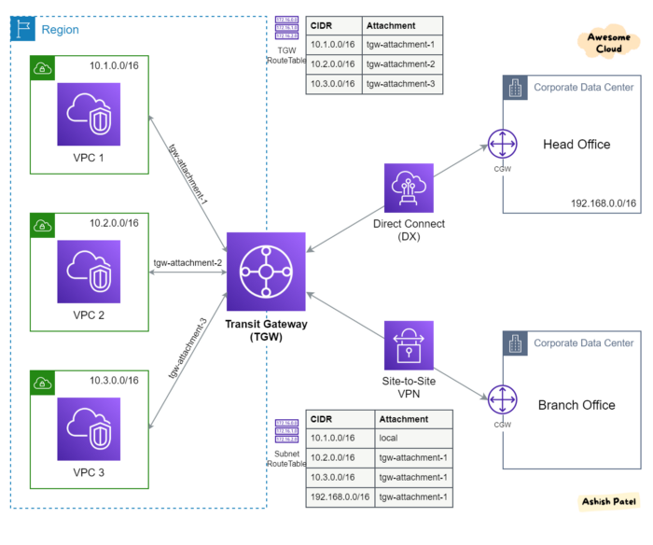
Networking from On-Prem to Cloud: Extending On-Prem
Hub & Spoke Model with Transit Gateway

Slide 50
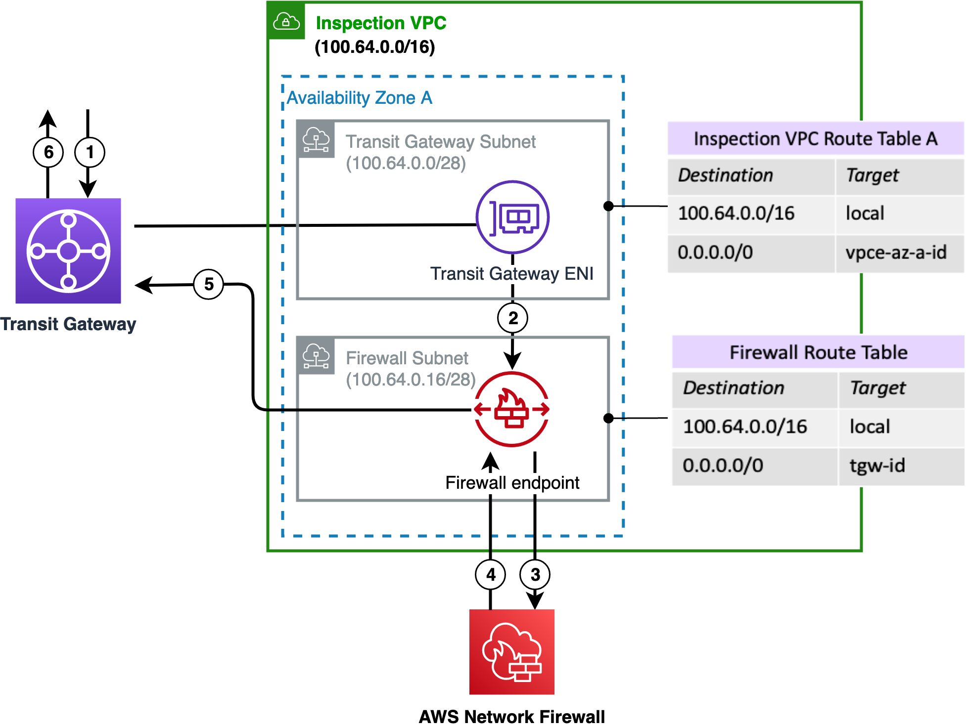
Networking from On-Prem to Cloud: Extending On-Prem
Inspection VPC

Slide 51
Networking from On-Prem to Cloud: Security Best Practices
Limit public-facing resources. If it doesn’t need to be publicly accessed, keep it private.
Use load balancers, application load balancers, web application firewalls, etc. where appropriate for your needs.
Use Private Endpoints
With PrivateLink, traffic between a VPC and other Amazon service communications do not traverse through the public internet.
Enable VPC Flow Logs to track traffic between network interfaces within your VPCs.
Use VPC security groups
Security groups act as a virtual firewall to control inbound/outbound traffic.
Security groups act at the instance level and are stateful (return traffic is automatically allowed).

Slide 52

Part Five: Secure Pipeline & Automation

Slide 53
Secure CI/CD Pipeline & Automation: From Code to AWS
Any code that is deployed to an AWS service must be secured
If unsecured, access to the underlying host may result in privilege escalation
Applications are locally developed, pushed to code repositories, and then pushed into the AWS environment through a CI/CD pipeline
Pipeline credentials are used to authenticate to AWS, and must have admin-level privileges to deploy infrastructure and app components
Virtual machines (EC2) and Docker containers (ECS) used base images which must be secured
Image scanning is available through Amazon’s Elastic Container Repository

Slide 54
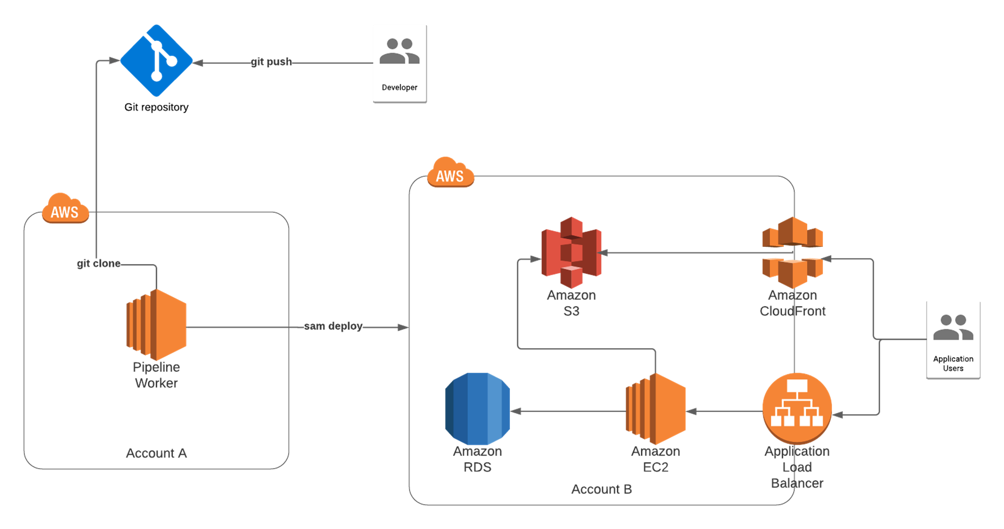
Secure CI/CD Pipeline & Automation: From Code to AWS

Slide 55
Secure Pipeline & Automation: Secure Software Development Lifecycle
Local Code Development
Restrict access to source code repository, with regular audits.
Git Source Control
Implement Pull Request validation and analysis.
Access to CI/CD tooling should follow principle of least privilege.
Continuous Deployment
Conduct regular scanning and analysis of resources after deployment, such as AWS Inspector scanning of ECS container images.
Resources exposing OS access must have endpoint security tools running.
Group-based SSO authentication is recommended.
Continuous Integration
Pull Requests reviewed and approved by two or more people.
CI/CD app should have read-only access to the code repository.
Container images must be scanned before deployment.
Use signed Git commits.
Run static code and dependency analysis.

Slide 56
Secure CI/CD Pipeline & Automation: From Code to AWS
Infrastructure as Code allows you to store infrastructure design and configuration as a stateful blueprint:
Benefits include centralization, version control, and standardization across your AWS environment
Provides portability and helps prevent configuration drift
AWS CloudFormation is an infrastructure automation platform for AWS that deploys AWS resources in a repeatable, testable and auditable manner.

Slide 57
Secure CI/CD Pipeline & Automation: Future State
Cloud configurations are deployed using Infrastructure as Code (IaC) templates such as Terraform, CloudFormation
An automated CI/CD pipeline is used to manage and deploy IaC to the AWS environment
IaC templates are reviewed and approved by a peer/supervisor prior to being deployed
Third-party code libraries are reviewed for security risks
The Software Development Lifecycle (SDLC) contains steps to assess software security including design reviews, code reviews, and static/dynamic application security testing
Source code scanning is built into the CI/CD pipeline and causes deployments to fail when security issues exist
IaC template scanning is built into the CI/CD pipeline and causes deployments to fail when configurations do not meet security requirements

Slide 58

Part Six: Pulling it All Together

Slide 59
Recap: Designing Cloud Security
Cloud Platform Design
Architecture (Account, Infrastructure & Application)
Network (Layout & Traffic Inspection)
Identity & Access Management
Secure CI/CD Pipeline & Automation
Service Protection & Hardening
Logging & Monitoring
Data Protection
Service-level Hardening
Resilience & Disaster Recovery
Policy & Process
Governance
Vulnerability Management
Incident Response

Slide 60
Pulling it All Together: Resilience & Disaster Recovery
Load balancers are deployed in front of apps and services for resiliency and capacity management
Basic DDoS protection is provided by the cloud provider
Redundant resources are deployed to maintain high availability for applications, and resources are deployed in multiple availability zones
Critical applications are deployed across disparate geographic regions
Storage volumes, databases, and unstructured data are backed up regularly and are monitored for backup compliance
Auto-scaling is enabled for infrastructure hosting application components or services with dynamic capacity requirements
Disaster recovery (DR) testing and/or disaster-focused table top exercises (TTX) are performed annually
Failover to application DR environments is done automatically
Advanced DDoS protection is in place, either through the cloud provider or a third party
A backup strategy has been implemented which includes immutable backups of critical data/systems being taken regularly, and validated

Slide 61
Pulling it All Together: Governance
Cloud environments are managed centrally
Roles and responsibilities for the cloud environment are defined
There is an organization strategy around the use of geographic regions offered by cloud providers
There is a process in place to manage changes to the cloud environment
A cloud security policy exists and is actively maintained
Security requirements and strategies (e.g., network security, data protection, logging and monitoring, etc.) have been documented and socialized with all cloud stakeholders
There is an approved service catalog with hardening standards for each approved service
Cloud environments are aligned with regulatory requirements and are regularly audited
A standard resource naming convention and tagging approach is in use
Unused regions and networks which are configured by default are cleaned up (deleted, disabled, etc.)
There is monitoring in place to identify shadow cloud environments

Slide 62
Pulling it All Together: Vulnerability Management
The cloud management plane is scanned for configuration risks
All cloud-hosted servers and other cloud resources are scanned for vulnerabilities on a regular basis
Cloud vulnerability data is tracked and reported as part of the organization's vulnerability management program
Containers are scanned for vulnerabilities upon deployment and on a regular basis
Infrastructure is patched within 90 days of vulnerabilities being identified
High-risk configurations are prevented or auto-remediated when detected where possible
Penetration tests and/or purple team exercises are performed on the cloud management and data planes
Infrastructure patching is completely automated with the CI/CD pipeline

Slide 63
Pulling it All Together: Incident Response
There is at least a dedicated security team member on-call at all times for security-related incidents
An incident management lifecycle exists which tracks incident priority and status
A Security Operations Center (SOC) team provides 24/7 monitoring and response for cloud security incidents
Incident response workflows/runbooks have been created for cloud security alerts
A process exists to identify gaps in security alerting capabilities and develop new detection capabilities and rules
A forensics capability exists for investigations into both cloud services and servers hosted in the cloud environment
Automated playbooks have been implemented for common IR activities such as blocking IP addresses from accessing resources

Slide 64

So Long and Thanks for All the Fish!
Cassandra Young
Twitter: @muteki_rtw
GitHub: github.com/muteki-apps
LinkedIn: linkedin.com/in/cassandray

Slide 65
Extra Slides

Slide 66
Activity 4: 10 mins (drop if no time)
Configure Private Endpoint for S3
Private Endpoints
< link to GitHub – repo has more detailed steps >

Slide 67
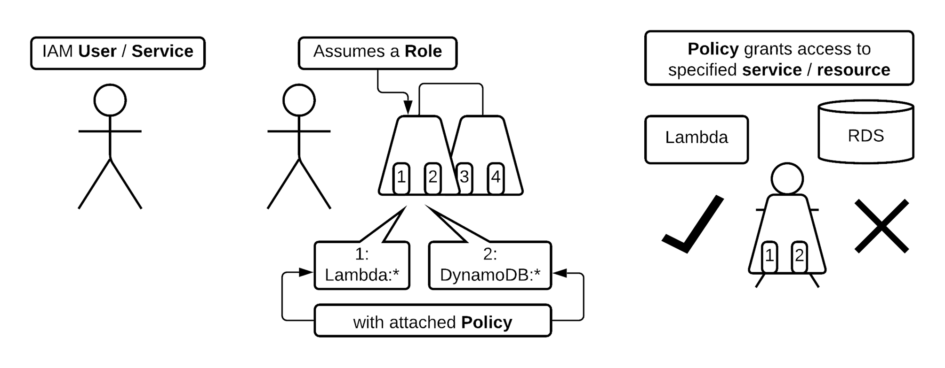
Identity & Access Management: Bringing it all Together

